Slide 1
Minuteman Trail right of way
two family
Single family
~50 ft.
Figure 1. Screenshot from Arlington GIS map showing single family and two family houses lining the Minuteman Trail just south of Spy Pond. The scale is approximate; the purpose of this map is to identify buildings.

Slide 2
30
20
10
Feet above trail
level
0
-10
-20
-30
Feet below trail
-40
50
100
150
200
number of houses
Figure 2. Altitude of land around 238 buildings abutting the Minuteman Trail in Arlington, relative to the trail (trail = 0), based on visual estimates.

Slide 3
Extensive foliage covers trail
~50 ft.
Figure 2. Same area as in Figure 1 photographed June 18, 2010. The leaf canopy of deciduous trees completely obscures the trail. Google Earth.

Slide 4
Trail is visible through branches
Google Earth ruler used to measure distance to house
~50 ft.
Figure 2. Same area as in Figures 1 & 2 photographed April 17, 2008. The absense of leaves allows clear visualization of the trail. Distances from the trail to abutting houses can be measured using the ruler tool in Google Earth.

Slide 5
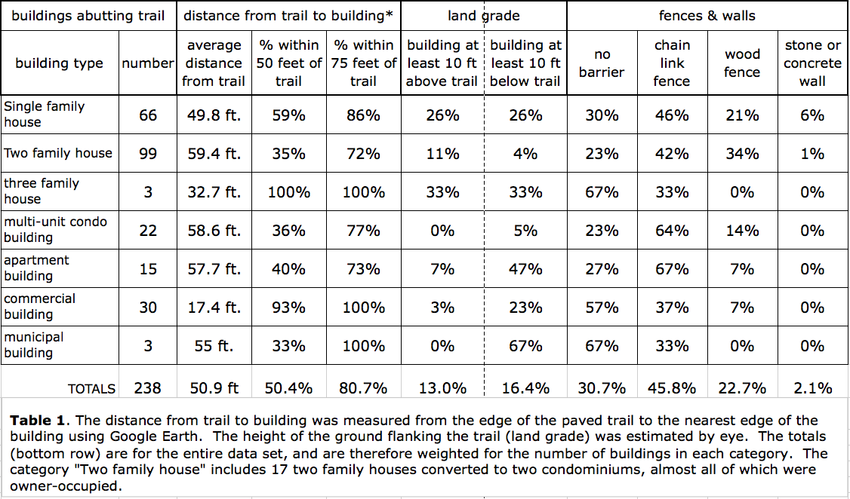

Slide 6
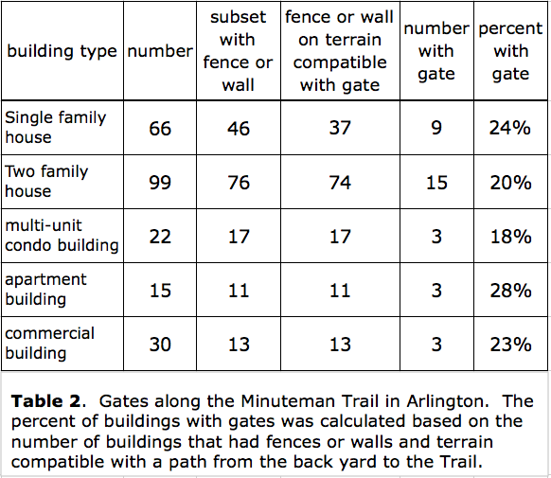

Slide 7
